Slide 1
How the role of Recycling affects
Health and the Environment

Slide 2
Mark Gardner
Energy Specialist
Lake Shore Central School District
My role as energy specialist is to:
Reduce energy costs throughout the district.
In five years and four months we have reduced our energy costs at Lake Shore by $1,027,409 or 22.6%.
Push into the classrooms and teach students about energy conservation subjects.
Promote Lake Shore Central’s Energy Conservation Program in the community.

Slide 3
What role does recycling play on our health
and the health of the environment?
Most students know what it means to recycle and that it’s the right thing to do.
Besides growing up in the first generation where recycling is discussed regularly, you are also the nations largest consumer demographic, so it’s of the upmost importance that you’re informed and inspired to be part of the solution.

Slide 4
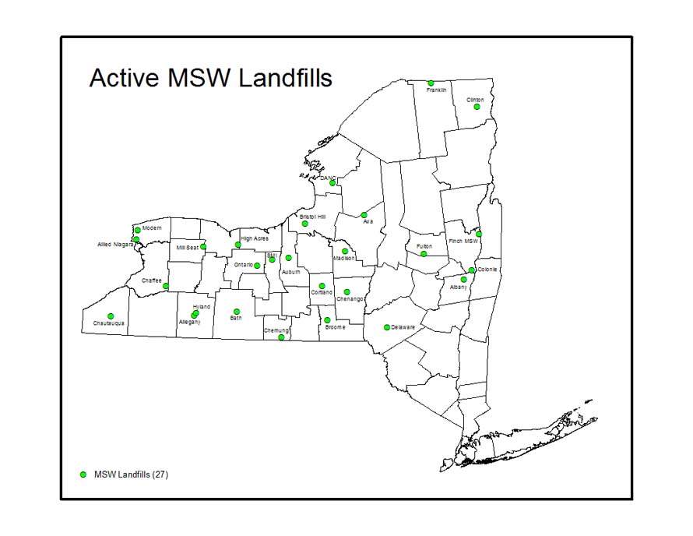
Municipal Solid Waste Landfills

Slide 5
Landfills
As of December 2019, there were 27 active MSW landfills in New York State. The landfills have approximately 200 million tons of capacity remaining including capacity of actually constructed landfills and those which have not yet constructed but permitted to be constructed. This equates to approximately 23.3 years of capacity at 7.9 million tons per year.

Slide 6
What Goes into Landfills?
Household Trash
Commercial Non-Hazardous waste
Construction Debris
Items not Recyclable

Slide 7
What can be Recycled
Newspapers, Magazines and Catalogs
Corrugated Cardboard
Glass Bottles
Metal Cans
Plastics #1 - #7
Milk Cartons, Juice Cartons & Drink Boxes

Slide 8
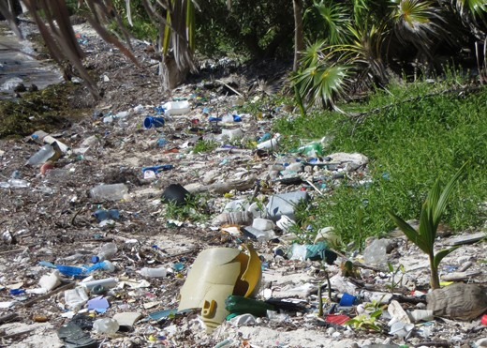
Plastic pollution: our disposable life

Slide 9
Plastic Pollution: our
disposable life
At present we are several steps away from a circular economy, and plastic production use and waste is booming. Recycling is important, where it happens. But much of our plastic still ends up in landfills, where it will persist for centuries. More worryingly, lots of plastic escapes from any waste management and eventually ends up in our rivers and seas, where it will stay for centuries.

Slide 10
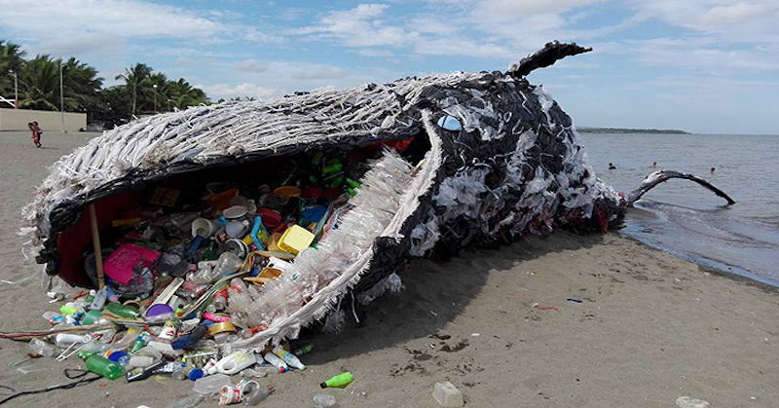
Plastic pollution: our disposable life

Slide 11
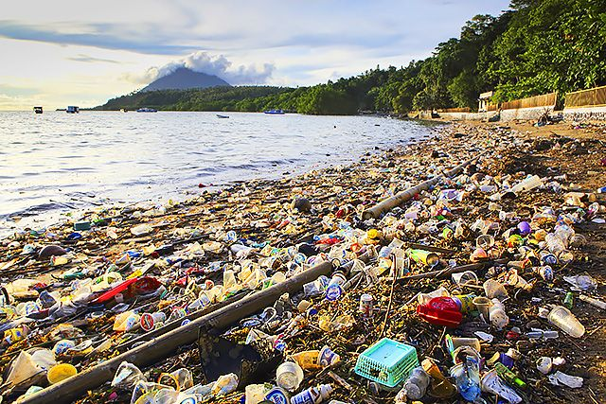
Plastic pollution: our disposable life

Slide 12
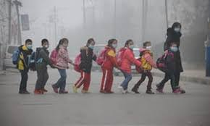
Air pollution

